Slide 1

Road Surface Condition Detection using YOLOv9 for Intelligent Transportation Systems
Presented by,
Aarushi Ranjan (22051217)
Shourya Merchant(22051280)
Khushi Trivedi(2205741)
Kavya Dixit(2205132)
Shashank Shekhar(22051192)
Guided By,
Dr Soumya Ranjan Mishra

Slide 2
Contents
SL NO. | TITLES
1. | Introduction
2. | Literature Survey
3. | Proposed Methodology
4. | Dataset Sample
5. | Algorithms & Methodology
6. | Result and Conclusion
7. | Work-Plan
8. | References

Slide 3
Literature Survey
SLNO | PAPER TITLE | AUTHORS | TECHNIQUES USED | MERITS | DEMERITS
1 | Road Damage Detection Using Deep Neural Networks | M. Maeda, T. Sekimoto, Y. Seto | CNN, Object Detection | Fast detection, good accuracy | Limited detection in low-light conditions
2 | Automatic Road Surface Condition Monitoring using YOLOv5 | P. Nguyen, L. Tran | YOLOv5, Real-time inference | Real-time performance, efficient for embedded systems | Requires high-quality dataset
3 | Deep Learning-Based Pothole Detection in Road Images | S. A. Sattar, H. Rauf, S. I. Shah | YOLOv4, Transfer Learning | High precision, reduced false positives | Model complexity, requires GPU for training

Slide 4
Introduction
This project introduces an automated road surface condition detection system using the YOLOv9 algorithm to enhance safety and maintenance in Intelligent Transportation Systems (ITS).
The model is trained to detect 14 different road surface conditions, including dry, wet, snow-covered, and water-affected surfaces such as:
dry-asphalt-smooth, dry-concrete-smooth, dry-gravel, dry-mud, fresh-snow, ice, melted-snow, water-asphalt-smooth, water-concrete-smooth, water-mud, wet-asphalt-smooth, wet-concrete-smooth, wet-gravel, wet-mud.
YOLOv9c processes images by dividing them into grids and predicts bounding boxes and classes simultaneously, offering high-speed and accurate detection.
After training on a labeled image dataset, the model was applied to video data, processing each frame individually and compiling detections into a visual output video.
The results demonstrate strong accuracy and robustness across different environments, showing potential for scalable integration into smart transportation and urban infrastructure systems.

Slide 5
Methodology
Data Collection and Preparation: Utilize the Road Surface Classification Dataset (RSCD), corresponding to 14 material-based classes. The images were preprocessed to ensure consistency.
Dataset Sampling: A random sampling of the original dataset was done to enable model learning, performance monitoring, and unbiased evaluation.
Data Annotation using Roboflow: Images were annotated using Roboflow, with each road surface material class labeled using bounding boxes to prepare the data for object detection.
Model Selection and Configuration: The model was trained on 16,500 images for 80 epochs using the GELAN-C architecture, one of the official backbones of the YOLOv9 framework.
Model Training and Evaluation: The model was trained on the prepared dataset using appropriate hyperparameters. Evaluation metrics such as mAP (mean Average Precision) were used to assess detection performance across all classes.

Slide 6
Dataset Description
The dataset utilized in this project is the Road Surface Classification Dataset (RSCD), which comprises approximately 1 million road surface images captured under diverse conditions. These images are categorized based on three primary properties: friction level, material, and unevenness, resulting in 27 distinct classes.
For this specific application, a subset of 16,500 images focusing solely on the material property was selected, encompassing 14 classes:
dry-asphalt-smooth, dry-concrete-smooth, dry-gravel, dry-mud, fresh-snow, ice, melted-snow, water-asphalt-smooth, water-concrete-smooth, water-mud, wet-asphalt-smooth, wet-concrete-smooth, wet-gravel, wet-mud.
The annotation of these images was performed using Roboflow, ensuring precise and efficient labeling. This meticulously curated dataset serves as a robust foundation for training the YOLOv9c model to accurately identify and classify various road surface materials.

Slide 7
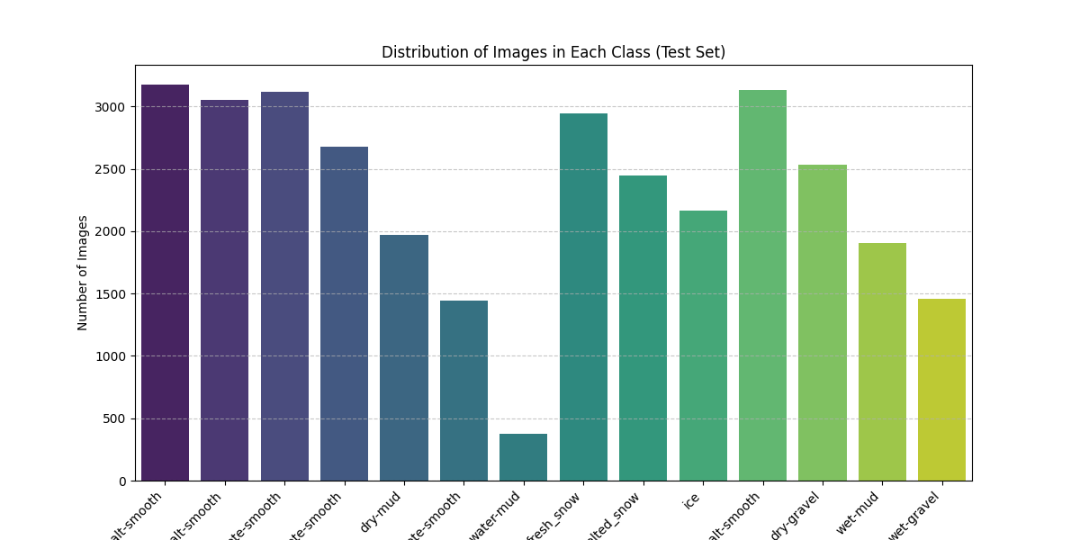
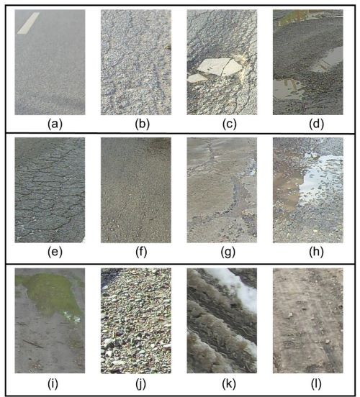
RSCD Dataset

Slide 8
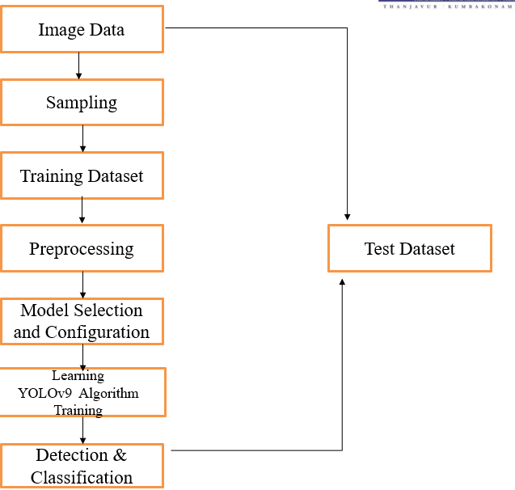
Workflow Diagram

Slide 9
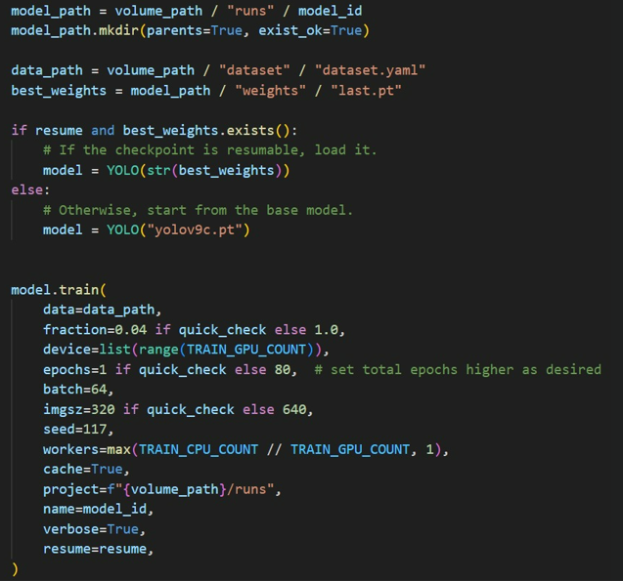
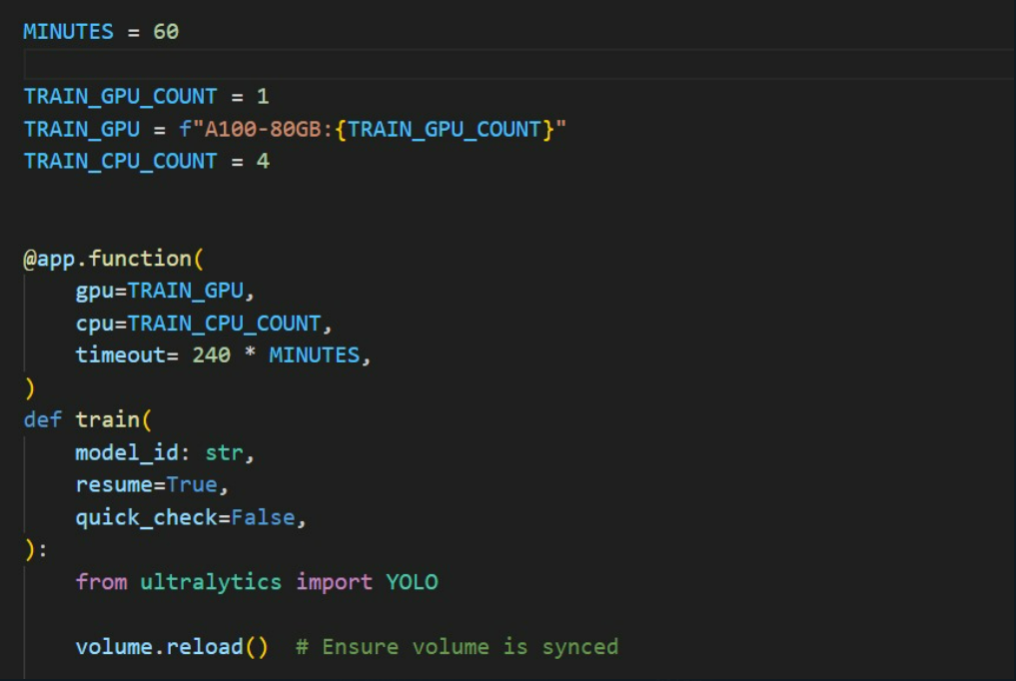
Training Code

Slide 10
References
F Quanwu Li and Shaopeng Duan, "Road Surface Crack Detection Based on Improved YOLOv9 Image Processing," International Journal of Advanced Computer Science and Applications (IJACSA), vol. 15, no. 11, pp. 590-598, Nov. 2024.
Gopal Singh S., Fardeen Feroz Khan, and Putikam Yashwanth, "YOLOv9-Based Pothole Detection: Enhancing Road Safety through Deep Learning," International Journal of Research Publication and Reviews (IJRPR), vol. 5, no. 7, pp. 31656, Jul.
2024.Prof. A. M. Jagtap, S. Pawar, P. Shinde, P. Ahetti, and A. Raut, "YOLOv9-Based Visual Detection of Road Hazards and Anomalies," International Journal for Research in Applied Science and Engineering Technology (IJRASET), vol. 13, no. 2, pp. 66913, Feb. 2025.

Slide 11
Results
The training process was meticulously monitored with key metrics such as precision, recall, and mean Average Precision (mAP), alongside loss function curves. The system demonstrated consistent decreases in training and validation loss, while performance metrics steadily improved. These trends reflect strong model generalization and convergence without overfitting. Evaluation over diverse environmental conditions confirms the model’s resilience and detection reliability.
Post-training, the model was deployed on video data, where individual frames were processed and recompiled into a video format for visualization. The confusion matrix highlights accurate classification across multiple terrain types, with minimal misclassifications, confirming the model's robustness and multi-class discrimination power.
The promising results suggest a high potential for integration into intelligent transport systems (ITS) and smart city infrastructures. This study paves the way for scalable, real-time, and adaptable solutions in road surface monitoring, contributing significantly to enhanced safety and predictive road maintenance.

Slide 12
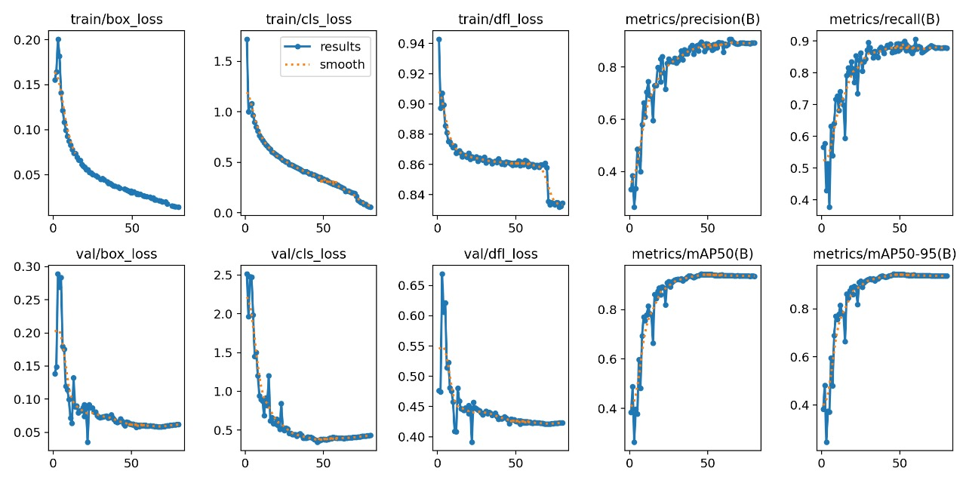
Results

Slide 13
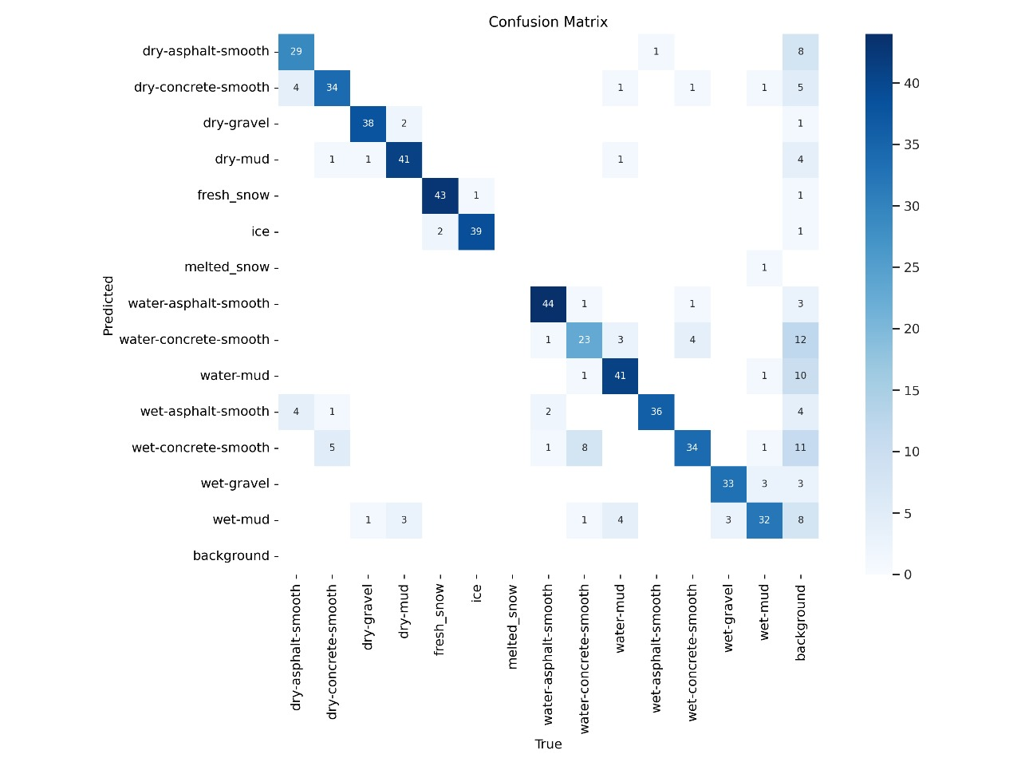
Results

Slide 14
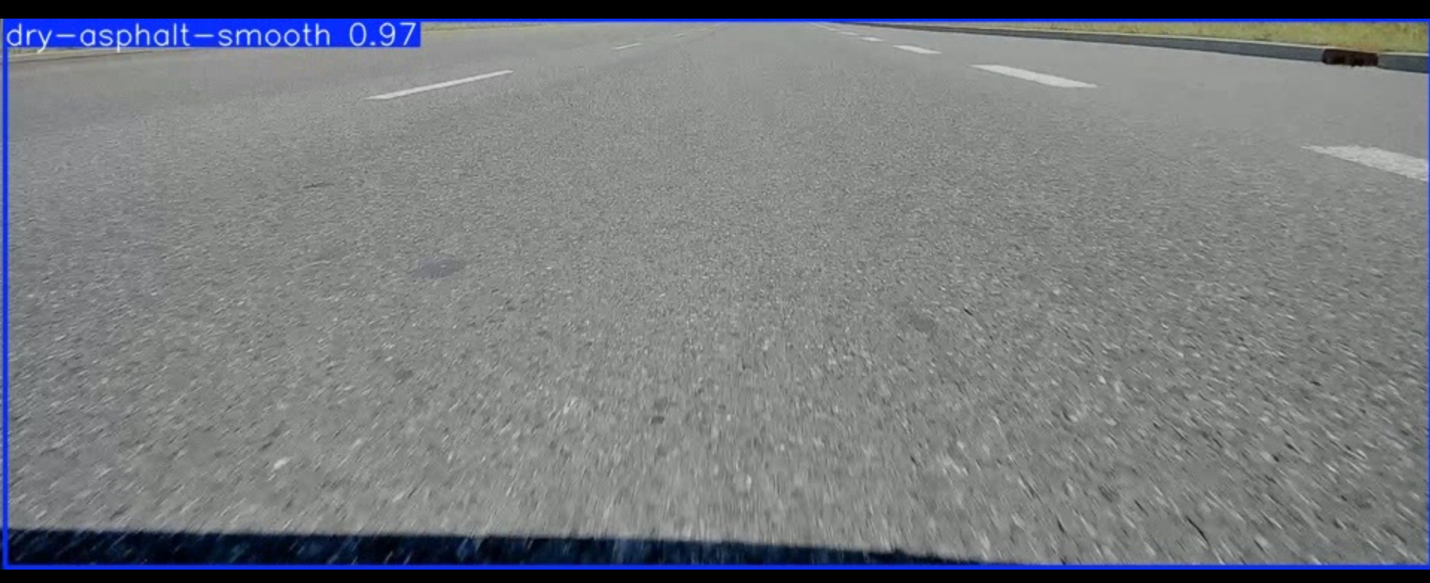
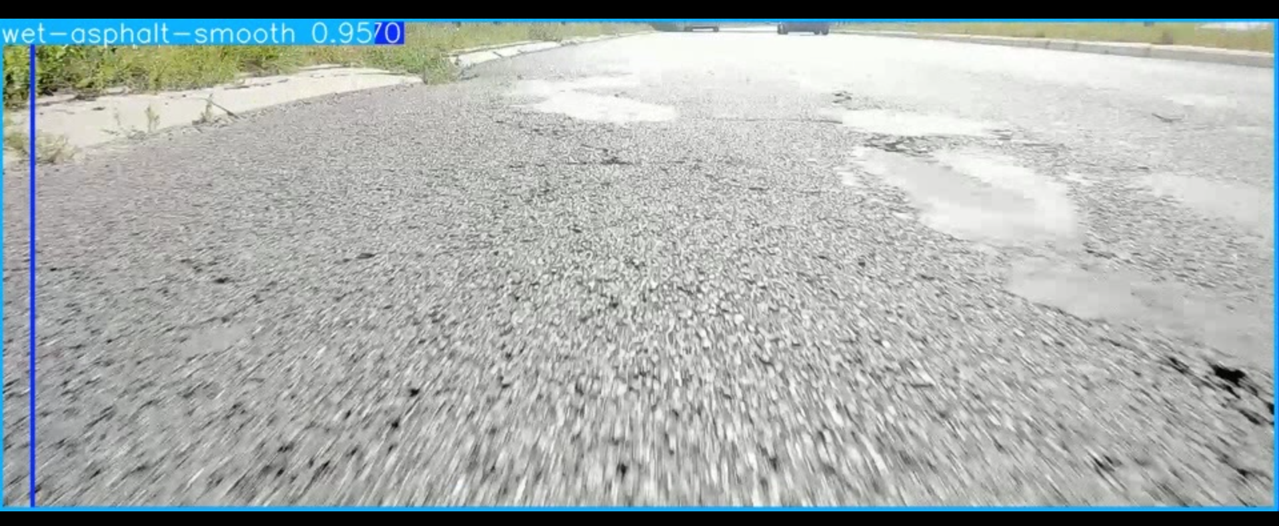
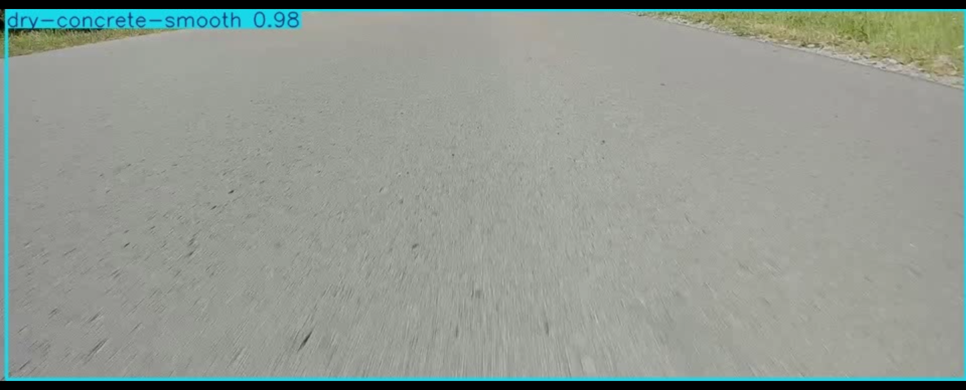
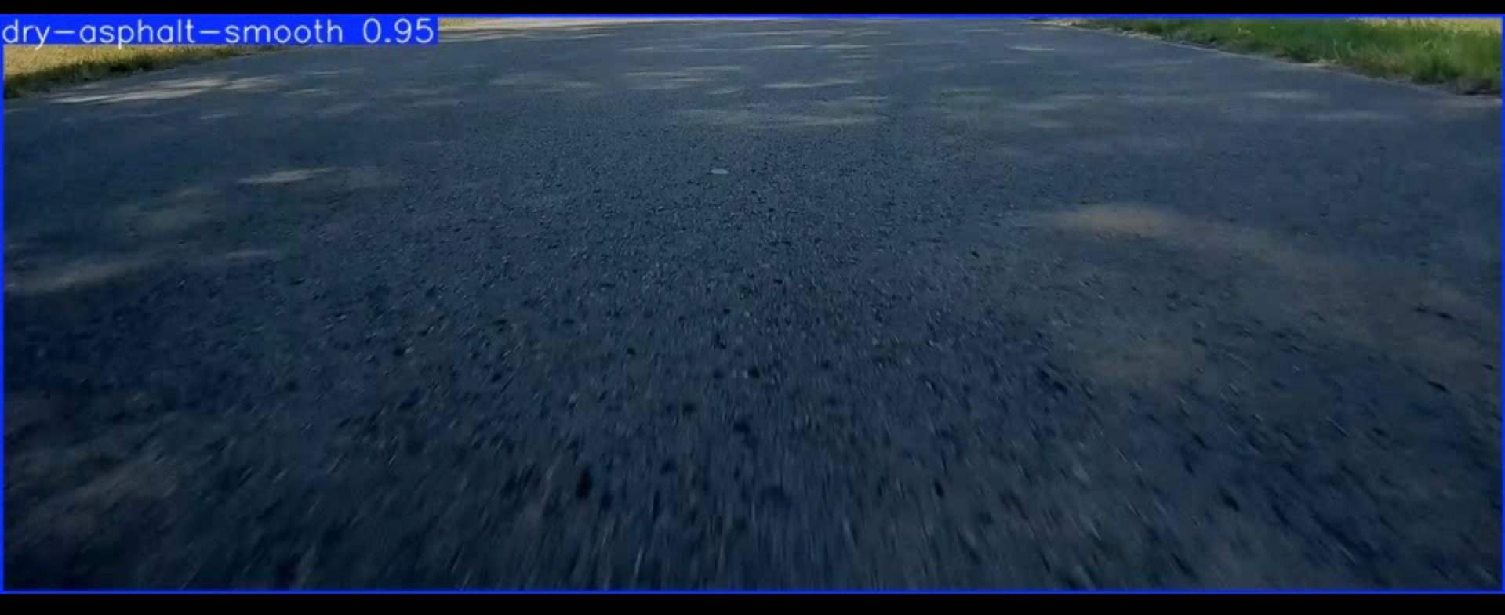
Sample Output

Slide 15
Thank you

